Slide 1

Wiring AI Into How
Houston Companies Grow
A conversation with JR Reale
Ali Mamujee | April 2026

Slide 2
MY BACKGROUND
Houstonian with 20 years of investment and operator experience.
Cleantech - IB / PE / VC
Mercatus – SaaS Fintech for PE Investors
Pricing I/O
2006
2026
Frog Capital, Element Markets, UBS, VERT
11 years building strategy, GTM, and product
Advisor, VP Growth
STATE STREET
Acquired 2021
MY UNIQUE VALUE
Capital markets foundation
IB, PE, and venture-backed fundamentals. Strong valuations background.
Builder: 11 years, one company, 9-figure exit
Employee #5 at Mercatus. 9 figure exit. Built GTM from zero. Owned Strategy, Product, and Marketing. Acquired by State Street in 2021.
AI operator since 2021
Led AI private markets initiatives in State Street and obsessed about AI ever since.

Slide 3
WHERE I START
What every great company does
CREATES
UNIQUE VALUE
Communicates Unique Value
Delivers Unique Value
Positioning
Customer Experience
Messaging
Operations
GTM
Expansion

Slide 4
How I Architect & Diagnose Companies Top Issues
Communicate
Deliver
AWARENESS
EDUCATE
SELECT
ACTIVATE
IMPACT
EXPAND
Problem Aware
Exploring Solutions
Deciding Us
Onboarding
Delivering Value
Expanding Value
Identified to MQL
MQL to SQL
SQL to Close
Close to Onboard
Onboard to Impact
Impact to Grow
Content/Blog
Newsletter
Podcast
Events
LinkedIn
Webinars
Website Visitors
Lead Magnets
Form Subs.
Services Page
Referral Intros
Discovery Call
Diagnostic
Design
Negotiate
Close
Handoff
Kickoff
Discover
Design
Deliver
NPS/Testimonial
ROI Documentation
Client Innovation
Referral Ask
New Engagement
Check-in Cadence
Client Workship
Cross-Sell

Slide 5
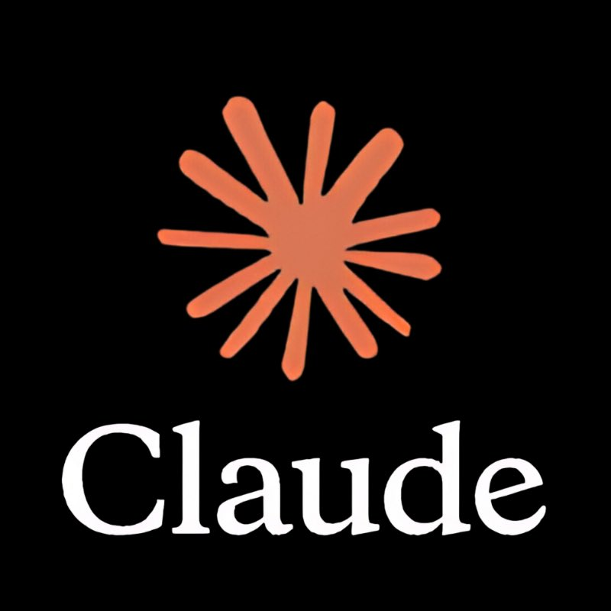

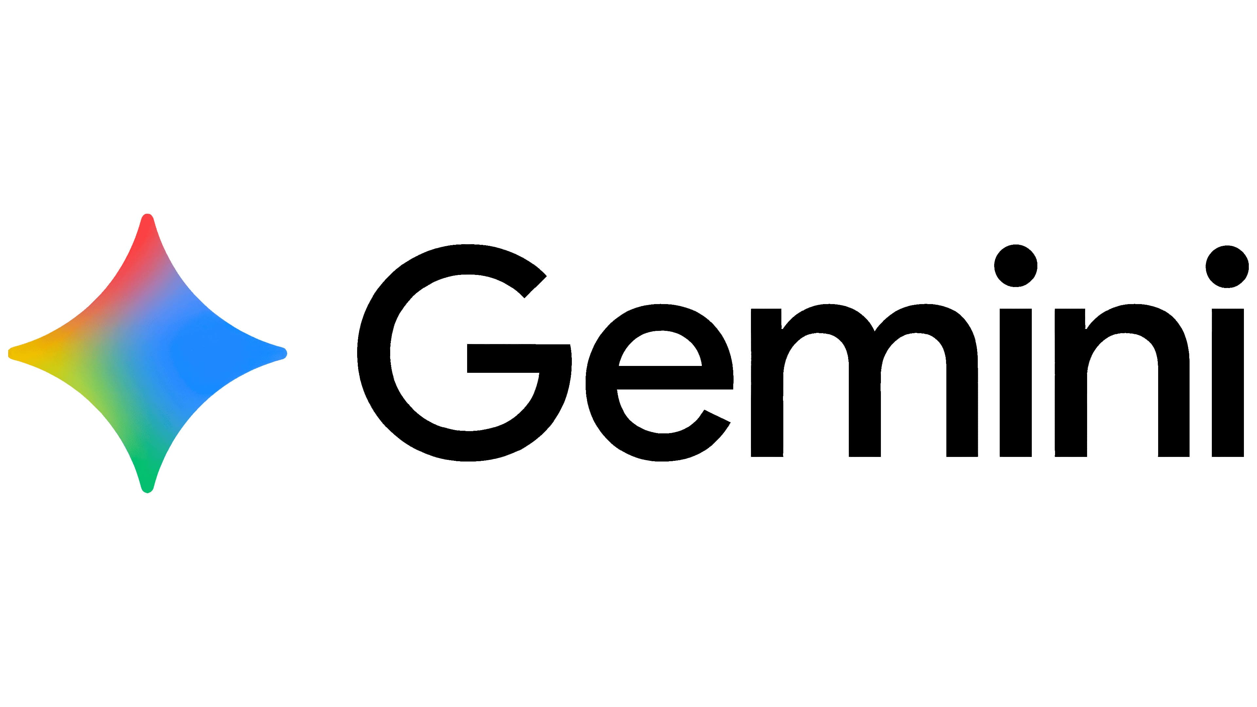
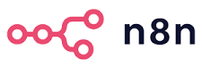




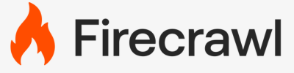

5 Most Common AI Automation driving real value right now
Stage | Category | Business Outcome | High Impact Use Case | AI Tools
1. More Leads | SEO, Website, Lead Magnet, GTM Engineering, Content Strategy | Drive organic traffic and identify high-intent visitors before they fill a form. | B2B SaaS: Auto-creating 50+ SEO landing pages from real-time competitor keyword gaps and search trends.
2. Speed to Lead | Automated and scalable omnichannel Qualification | Instant 24/7 response via voice, SMS, or email to qualify and book demos. | Home Services: AI voice agent calling leads at website submission, qualifying budget, and booking directly into the CRM.
3. Document Processing | Fulfillment, Onboarding, Contracts, Invoices | Remove the manual paperwork wall between signed contract and service delivery. Efficiency and risk mitigation. | Legal Firm: Auto-extracting line items from 200+ weekly PDFs and syncing to accounting to trigger kickoffs.
4. Database Reactivation | LTV, Retention, Win-Backs | Identify and re-engage dormant leads with zero additional ad spend. | Gym: AI scans the CRM for 6-month dormant customers and sends personalized win-back offers.
5. Internal Reporting | Operations, KPIs, Anomaly Detection | Real-time visibility into funnel clogs via proactive Slack or email alerts. | Sales Leadership: Daily Slack report flagging stalled deals, client needs, and alerting the VP of Sales to conversion bottlenecks.
Source: Reddit, YouTube, Gemeni Research

Slide 6


THE WORK IN PROGRESS OFFER
Train. Diagnose. Build.
A three-stage system for moving companies from AI curiosity to AI infrastructure.
STAGE 1
STAGE 2
STAGE 3
AI Spark
AI Ignition Map
AI Growth Engine
90-minute interactive training
2-week diagnostic
Build ROI Automations
1on1 or small team training on what AI can do for their business. Shared vocabulary. Clear next step.
Complete map of current workflows, disconnected systems, and the 3 highest-value AI opportunities ranked by ROI.
AI operating system installed. Agentic workflows live inside existing stack. Connected, measurable, compounding.

Slide 7
SECURITY & GOVERNANCE
Top AI barriers for companies
Barrier | Risk | Enterprise-Grade Mitigation
Data Trust Gap | Siloed data causes AI hallucinations and unreliable insights. | RAG pipelines and enterprise search ground AI in verified internal data.
Security & IP Leakage | Proprietary data may be exposed or used to train public models. Where is data sourced, processed, stored? | Enterprise contracts with Zero Data Retention and no-training guarantees.
Shadow AI | Unvetted accounts create tool sprawl and compliance risks. | SSO, role-based access, and audit logging give IT full control.
Pilot Purgatory | Projects stall as prototypes due to lack of ROI or production paths. | Organization led agentic workflows with human-in-the-loop gates bridge pilot to production.
Talent Shortage | Lack of technical expertise to build and secure complex AI systems. | Low-code tools and long-context models let domain experts orchestrate AI.
Source: Gartner, Top Strategic Technology Trends for 2026: AI Security Platforms and Multiagent Systems

Slide 8
WHAT WE COULD BUILD TOGETHER
A Houston AI flywheel
Three programs now. A capital layer when the ecosystem earns it.
1
The Founder AI Diagnostic
2
The Houston AI Builder Program
3
The Ion Corporate AI Partnership
A one-day working session and branded report. Every Alliance founder leaves with a ranked 90-day AI plan tied to their biggest business bottleneck.
A paid cohort program that trains AI-first operators, not engineers. Houston's answer to Gauntlet, built around business outcomes.
Quarterly 1-day intensives where corporate innovation teams learn alongside founders. Designed in-house, delivered by rotating faculty.
Scalable founder benefit. Portfolio-level data asset.
Tuition revenue. Talent pipeline for portfolio and partners.
Recurring corporate revenue. Warm LP pipeline.
→ THEN
Closes the capital loop.
Puts Houston on the AI map.
The Houston AI Innovation Fund
A focused early-stage AI fund. Alliance sponsored. Corporate partners and family offices as LPs. The first three programs as the sourcing engine.

Slide 9
Q&A
Ali Mamujee
alimamujee.com
The Moat Newsletter (weekly)
LinkedIn: /in/alimamujee
ali@alimamujee.com

